Slide 1

MINI PROJECT - I
Members:
1.Parshuram Ghodake – A15
[2526UAI030]
2.Ajit Jamadade – A18
[2526UJAI043]
3.Rehan Jamadar – A19
[2526UJAI192]
4.Harsh Bhople – A45
[2526UAI122]
Under Guidance:
Amruta Mam & Nikhil Sir

Slide 2
Problem Statement:
To overcome the difficulties of manual timetable scheduling, changing faculty availability, classroom allocation issues, and scheduling conflicts. Traditional scheduling requires continuous checking and adjustments to prevent conflicts and becomes increasingly inefficient as the number of courses and departments grows.
Proposed Solutions:
Automated Timetable – Generate schedules automatically.
Conflict Prevention – Avoid faculty, room, and batch conflicts.
AI/ML Optimization – Create efficient schedules using intelligent algorithms.
Smart Room Allocation – Assign suitable rooms based on capacity and availability.
Dynamic Rescheduling – Update schedules when changes occur
Project Objectives:
Design a Smart Classroom System Integrate ML-based scheduling into a unified smart classroom management platform.
Generate Conflict-Free Timetables Automatically produce optimized timetables ensuring no teacher or room conflicts.
Improve Resource Utilization Maximize efficiency of classrooms, faculty time, and available time slots.
Enable Dynamic Rescheduling Support real-time rescheduling in response to unexpected changes in availability.

Slide 3
Modules & Short Description:
Institute Hours→ Set the college working days and teaching hours.
Break Management→ Add short breaks and lunch breaks in the timetable.
Years & Semesters→ Manage FY, SY, TY and their respective semesters.
Divisions & Batches→ Create and manage divisions like SY-A, SY-B, SY-C and lab batches.
Faculty Management→ Add teachers, their subjects, and their daily teaching limit.
Rooms & Labs→ Add classrooms and labs with their capacity and type.
Subjects & Allocation→ Add subjects, lectures/labs, weekly sessions, faculty and room preferences.
Timetable Generation→ Automatically creates the timetable while avoiding clashes.
Timetable View→ View the timetable class-wise, faculty-wise, classroom-wise, lab-wise, or master-wise.
Conflict Detection→ Shows subjects that could not be scheduled and explains the reason.

Slide 4






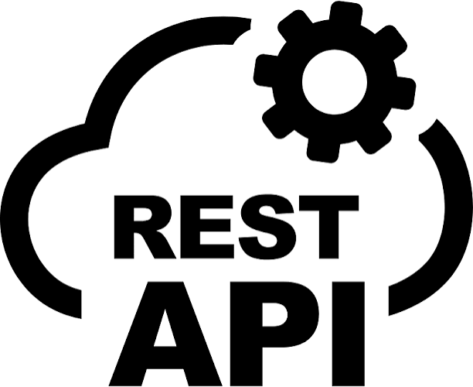


Technology Stack
Frontend
Database
Database Connector
Backend
API Comunication
Other Tools

Slide 5
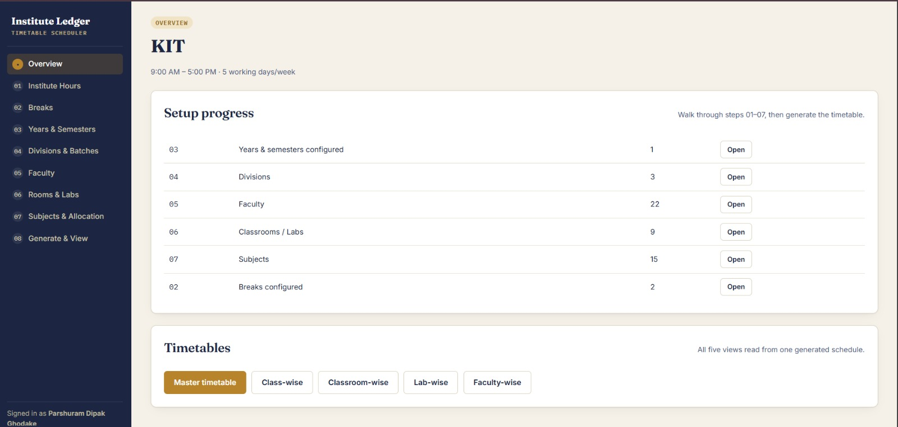
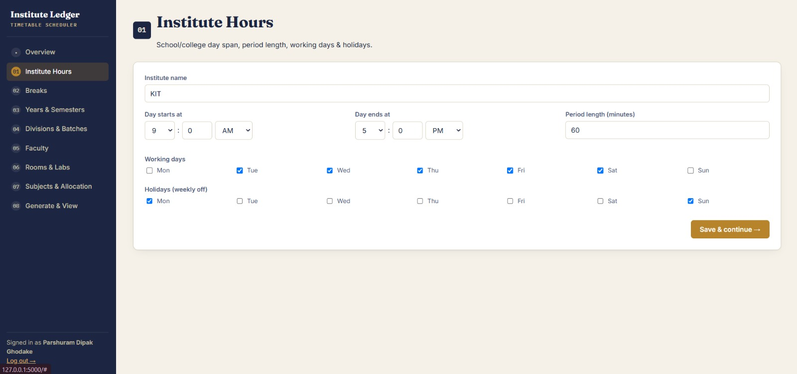
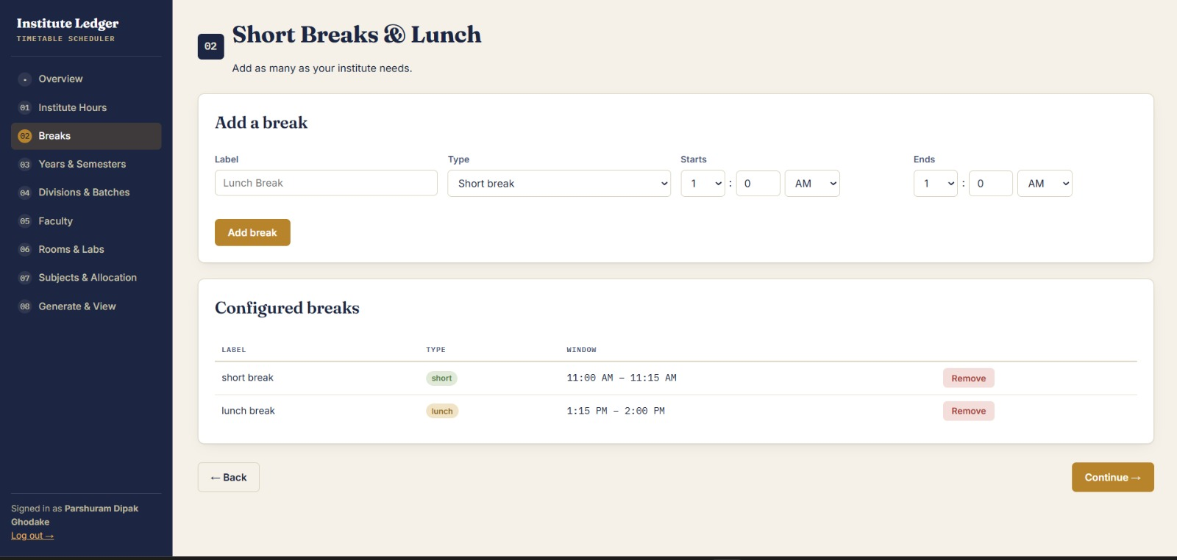
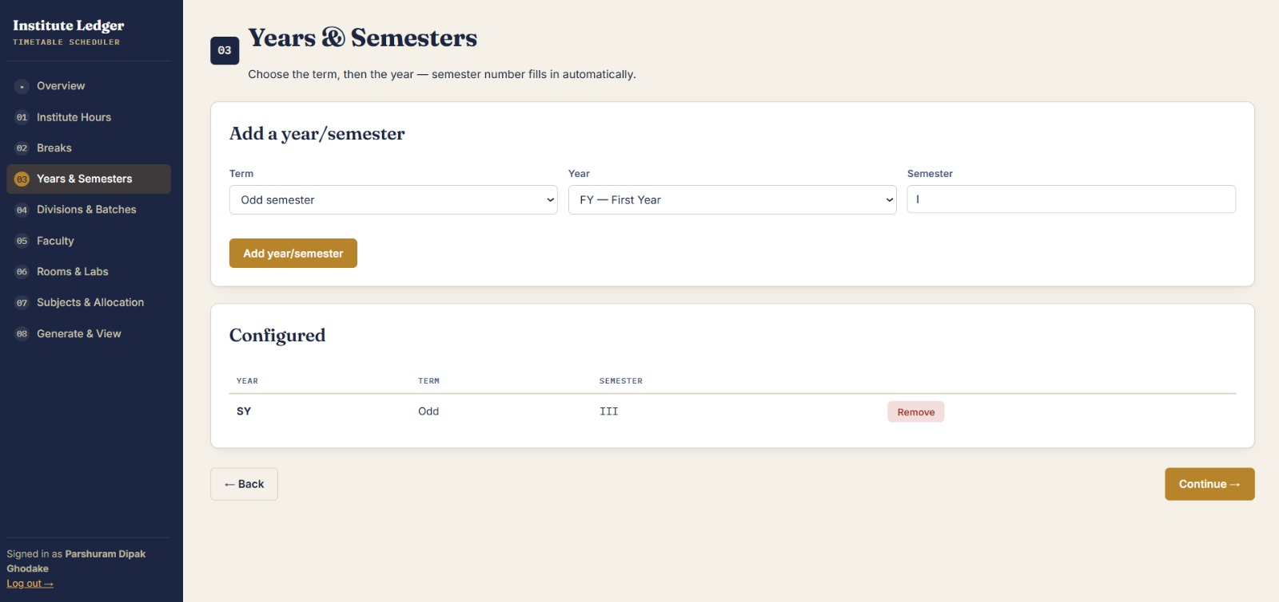
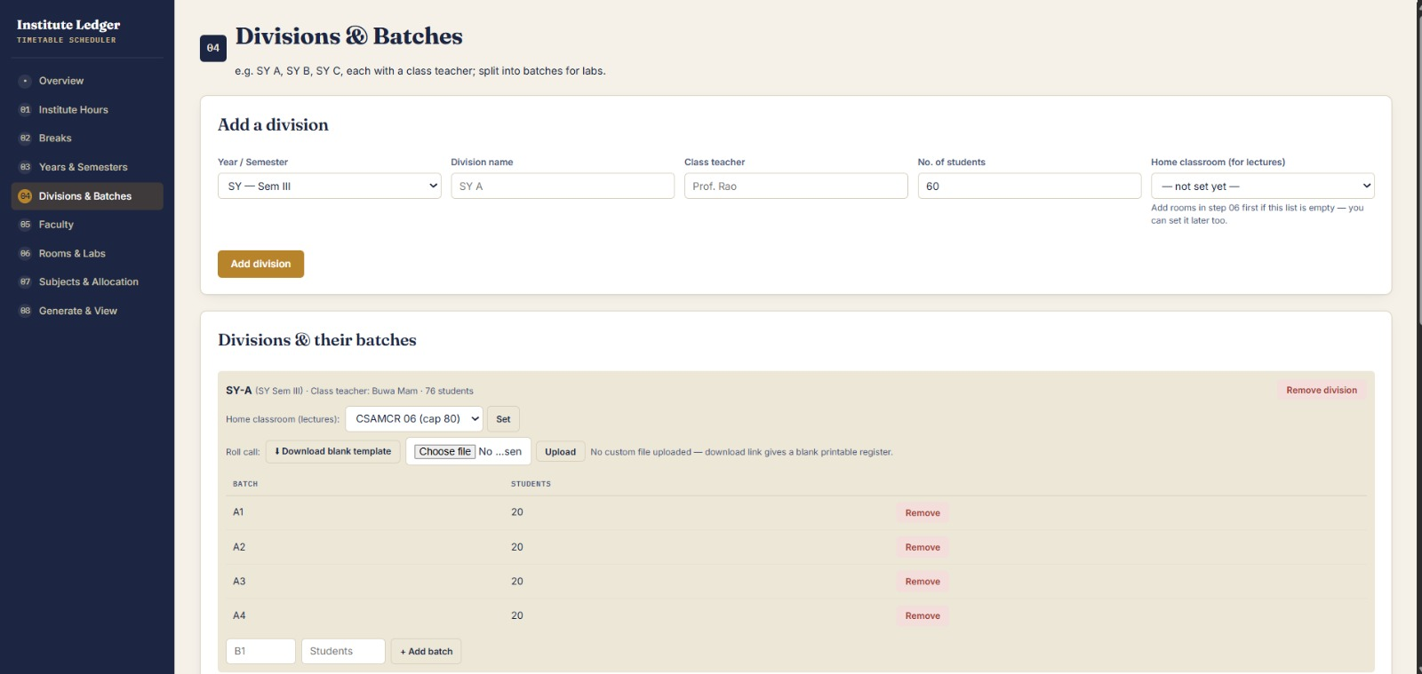
Frontend

Slide 6
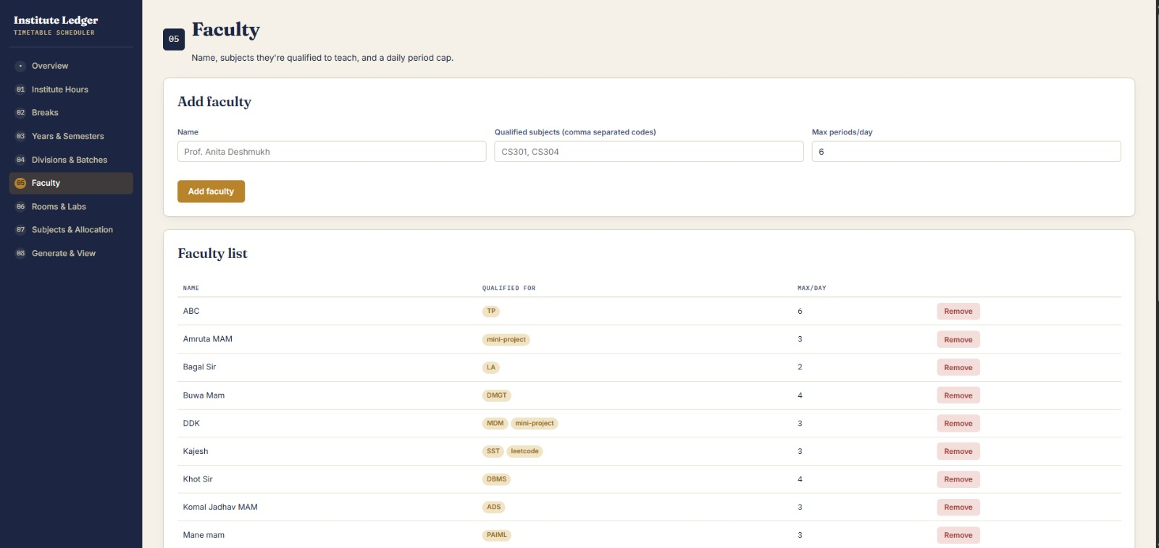
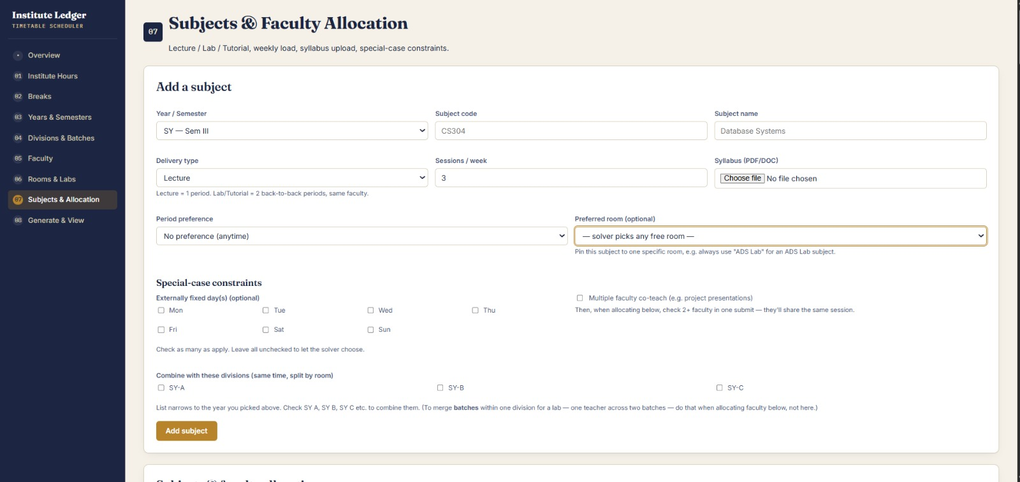
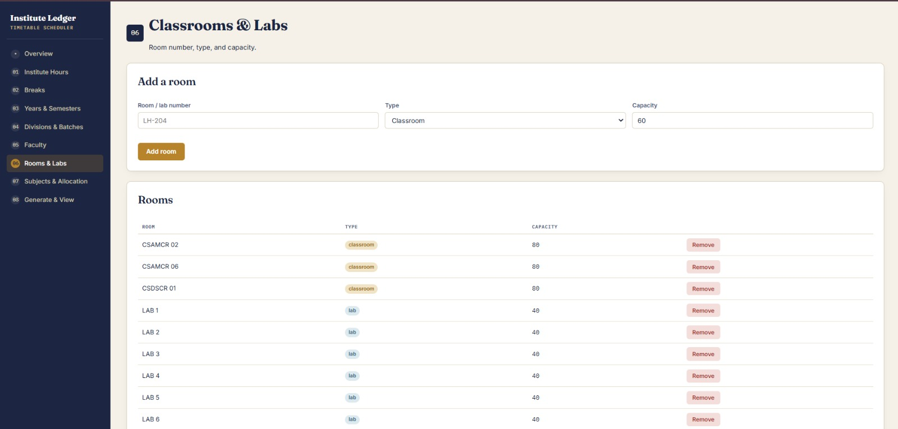
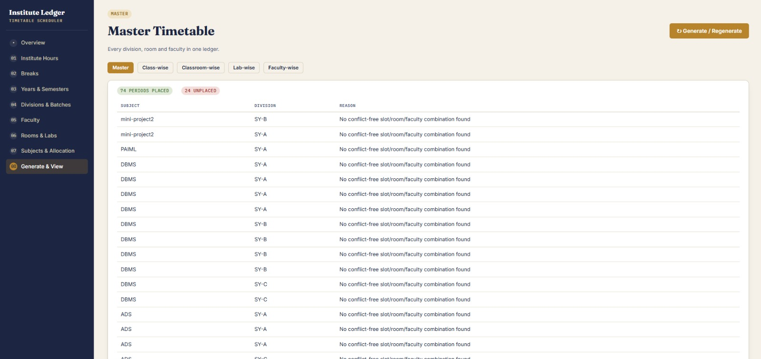
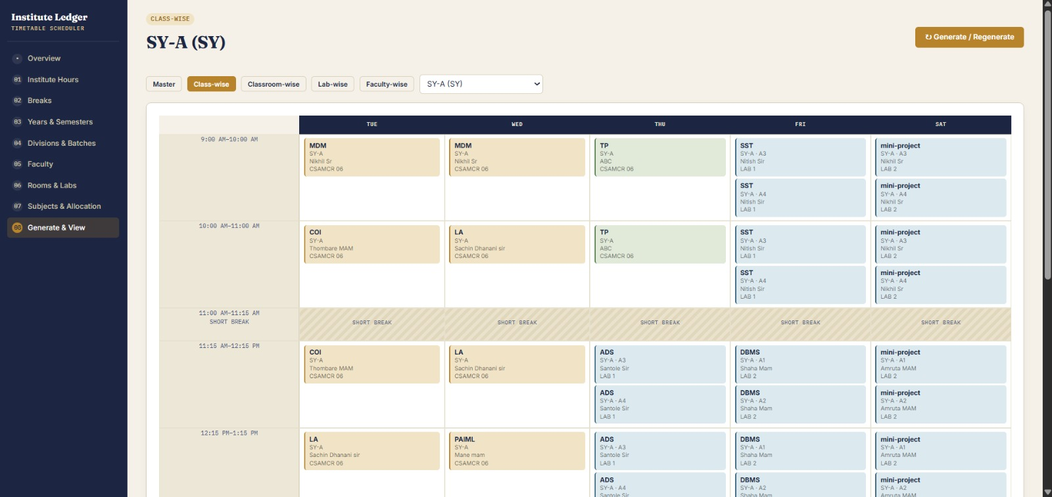

Slide 7
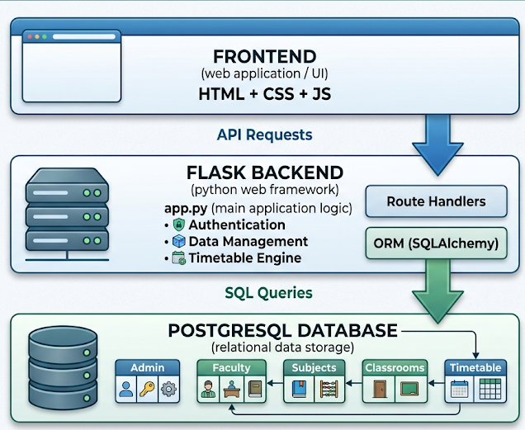
Backend Architecture & Technology
Backend Implementation
Backend Architecture:
Frontend → Flask Backend → PostgreSQL Database
The frontend (html, css, js) sends requests using the API.
The backend (py) processes requests and applies timetable scheduling logic.
PostgreSQL stores all application data.
The backend returns data in JSON format through REST API endpoints.
Backend Architecture

Slide 8
Backend Functionalities
1. User Authentication
The backend provides:
Admin Registration
Admin Login
Logout functionality
Session management
Password hashing for security
@app.route("/api/login", methods=["POST"])
def login():
data = request.get_json(force=True)
login_id = data.get("login_id")
password = data.get("password")

Slide 9
2. Data Management APIs
Timetable Generation Flow
The backend manages:
Academic Years
Divisions and Batches
Faculty Members
Classrooms and Labs
Subjects
Faculty Allocation
Institute Working Hours
Break Timings
All data is stored and retrieved using REST API endpoints.
Collect Institute Data
↓
Collect Faculty & Subjects
↓
Check Available Rooms
↓
Check Faculty Availability
↓
Find Conflict-Free Time Slot
↓
Allocate Classroom
↓
Store Timetable in Database

Slide 10
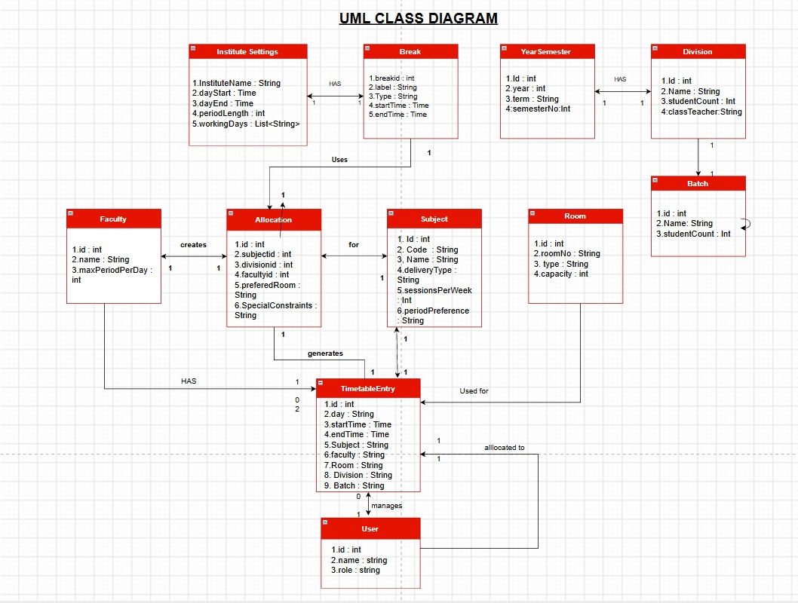
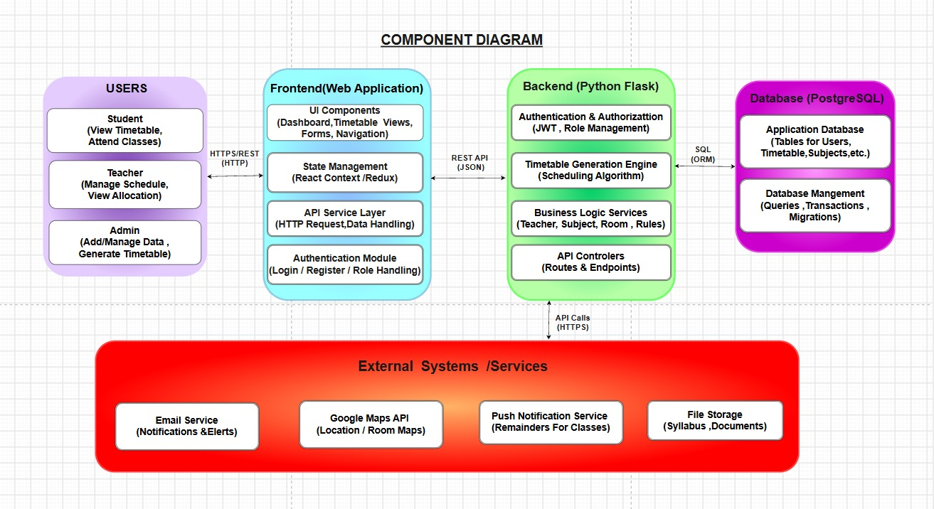
UML Diagrams:
1. Class Diagram
2. Component Diagram

Slide 11
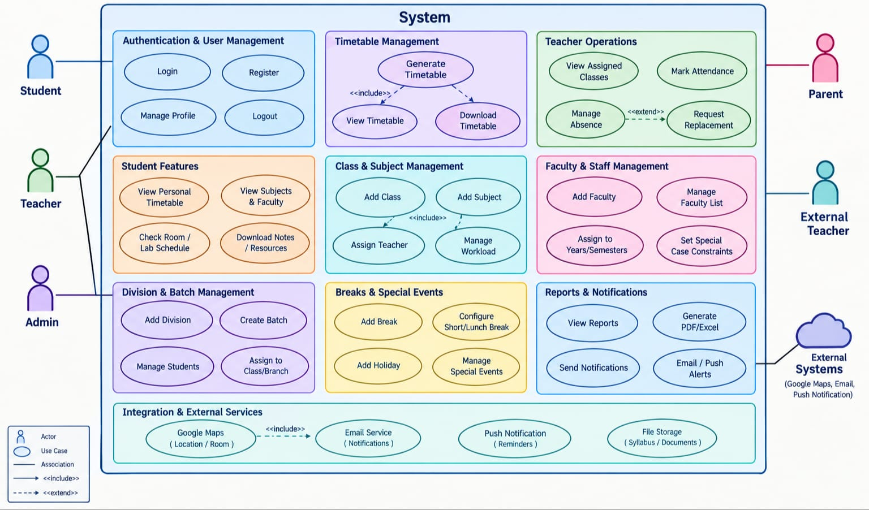
3. Use Case Diagram

Slide 12
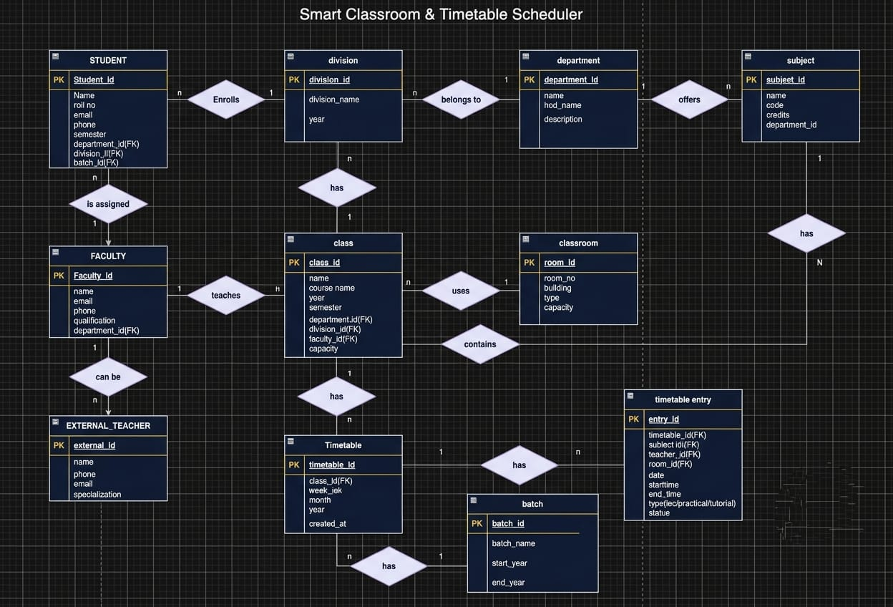
Database Design:
1.ER Diagram

Slide 13
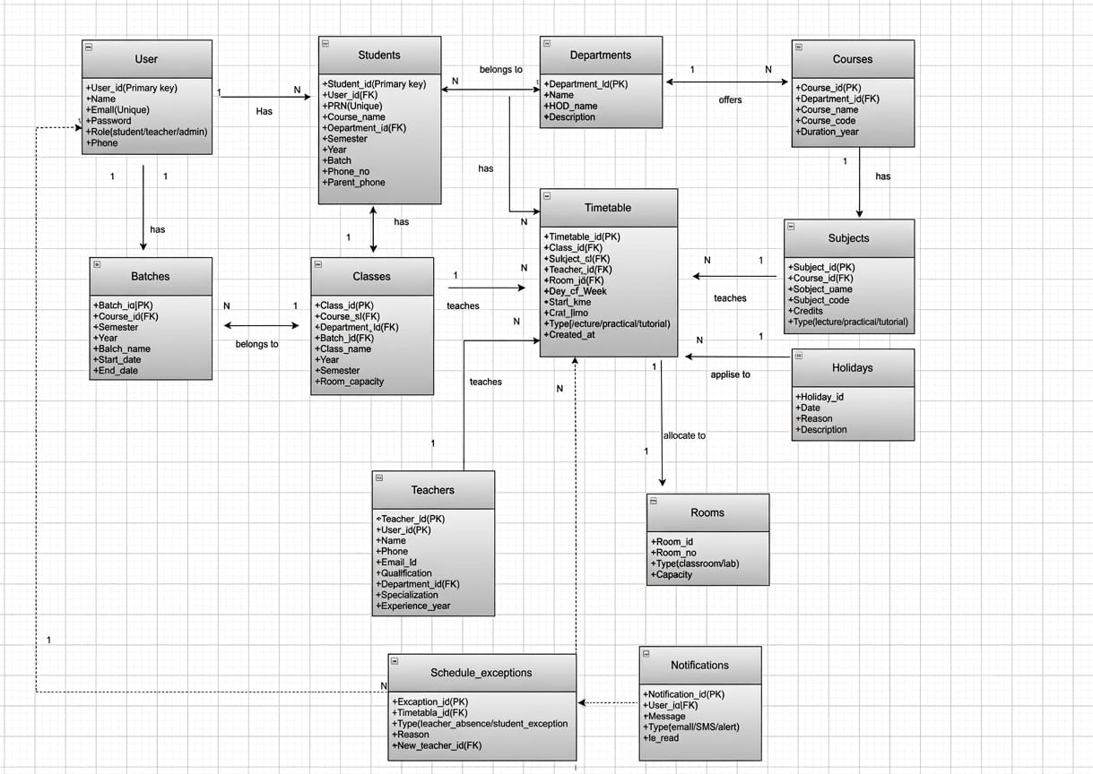
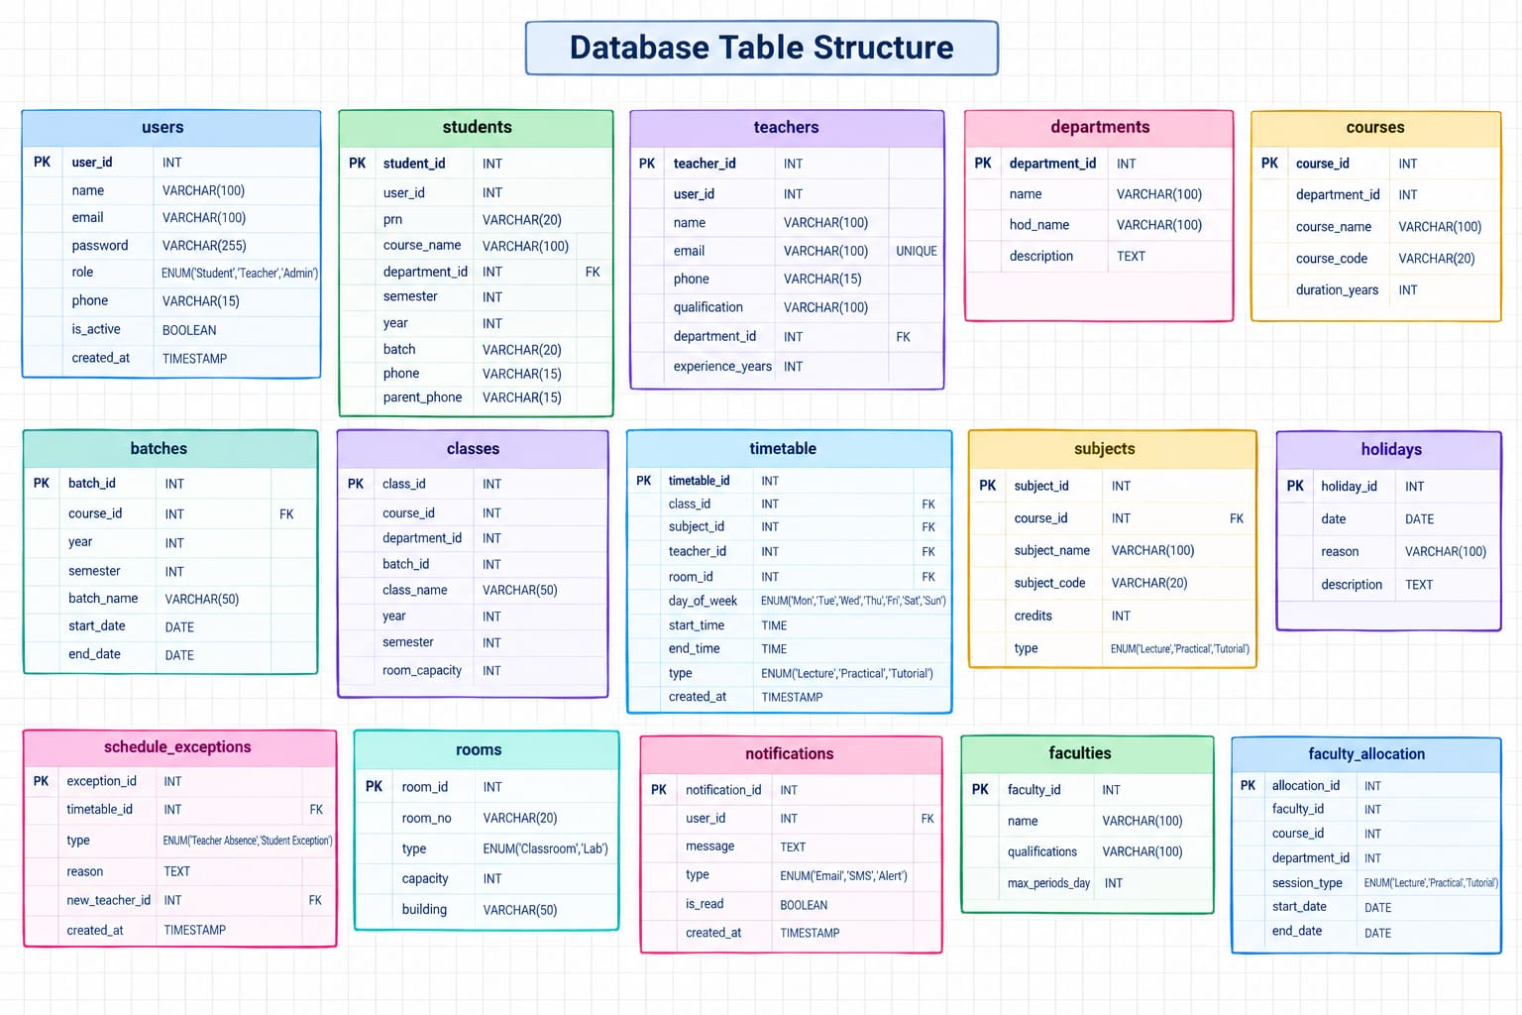
2.Database Schema
3. Database Table Structure

